Slide 1
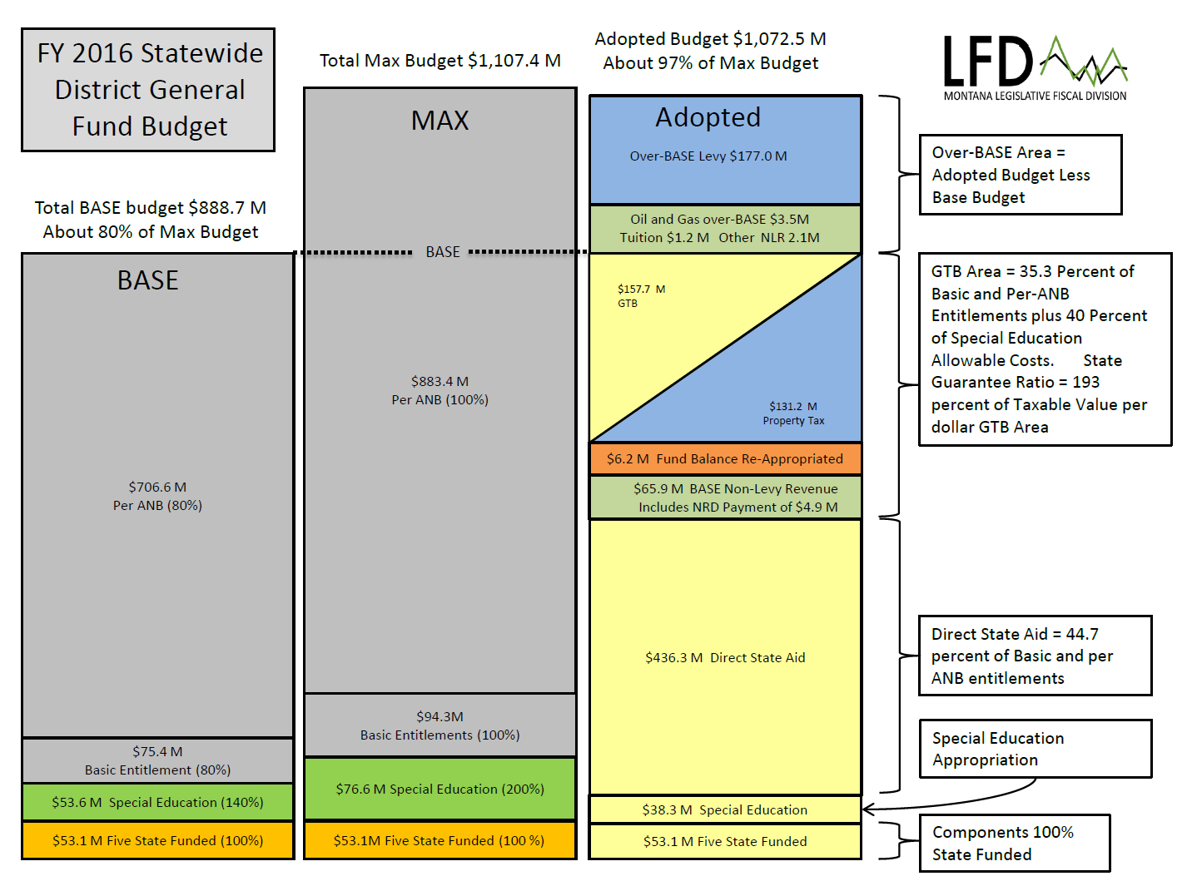
The major changes to the K-12 funding formula in the 2017 Legislature are related to the elimination of two district general fund sources of nonlevy revenue:
general fund block grants; and
the natural resource development K-12 funding payment (NRD)
and increases to state-funded Guaranteed Tax Base Aid (GTB).
These changes will affect property taxes in varying ways and to varying degrees in all Montana school districts over the next several years.
On the next slide we’ll examine the circled areas in greater detail. Note that the dollar amounts on this slide reflect FY 2016 and that the next slide will reflect FY 2017 and future years, fund balance re-appropriated will be excluded, and the diagonal line splitting GTB and local taxes will be reoriented vertically.

Slide 2
2017 (GTB 193%)
2018 (GTB 193%)
GTB Aid
$163 million
Local Prop Tax
$134 million
The elimination of block grants and the NRD payment in 2018 decreases nonlevy revenue significantly and results in increases in both GTB and local property taxes (BASE mills).
GTB Aid
will increase to about
$195 million
Local Prop Tax
will increase to about
$166 million
Nonlevy revenue
$70 million including:
$54 million in block grants
$8 million in NRD payment
Nonlevy revenue
2019 (GTB 216%)
2020 (GTB 224%), 2021… (GTB 232%)
But as the state funding that previously went to districts as block grants is redistributed by increasing the GTB multiplier over the next few years, GTB aid will increase and local property taxes (BASE mills) will generally decrease. More districts will be eligible for more GTB aid. However, some wealthy districts will still not be eligible for GTB aid and will pay more in BASE taxes than before. This is the result of distributing more state aid through equalizing GTB aid.
The share of GTB and local taxes varies from district to district based on local property tax wealth. Wealthier districts receive less or no GTB Aid; poorer districts receive more.
Local Prop Tax:
2019 - $153
2020 - $149
2021 - $148
GTB Aid:
2019 - $216
2020 - $224
2021 - $234
(in $ millions)
Nonlevy revenue
Data as per model 05-02-17K-12ModelMaster
Note—statewide local taxes are not expected to return to 2017 level due to projected ANB increases and inflationary adjustments to entitlement amounts

